Slide 1
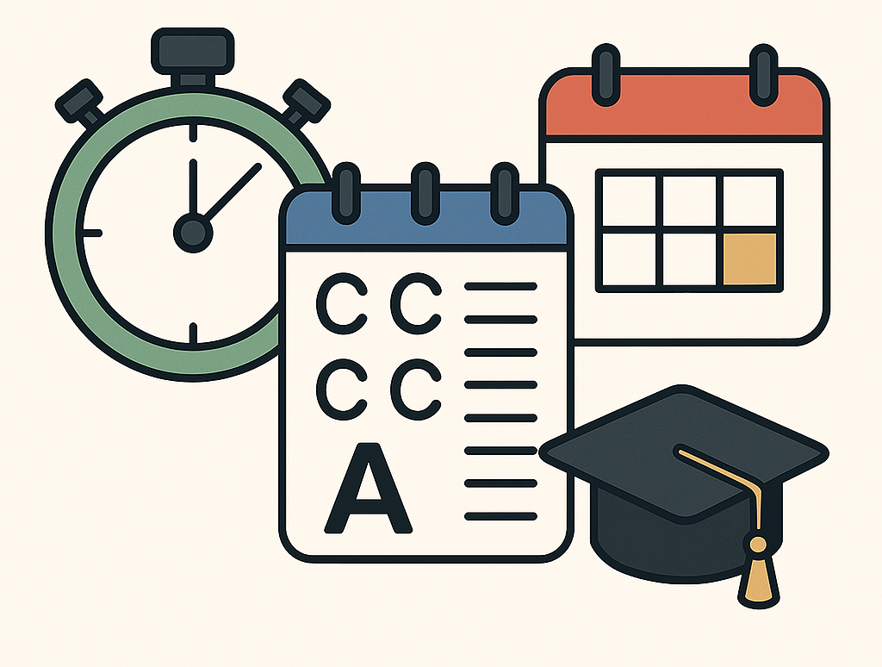
CSE 2100 Software Development Project I PROJECT PRESENTATION TrackMyStudy

Slide 2
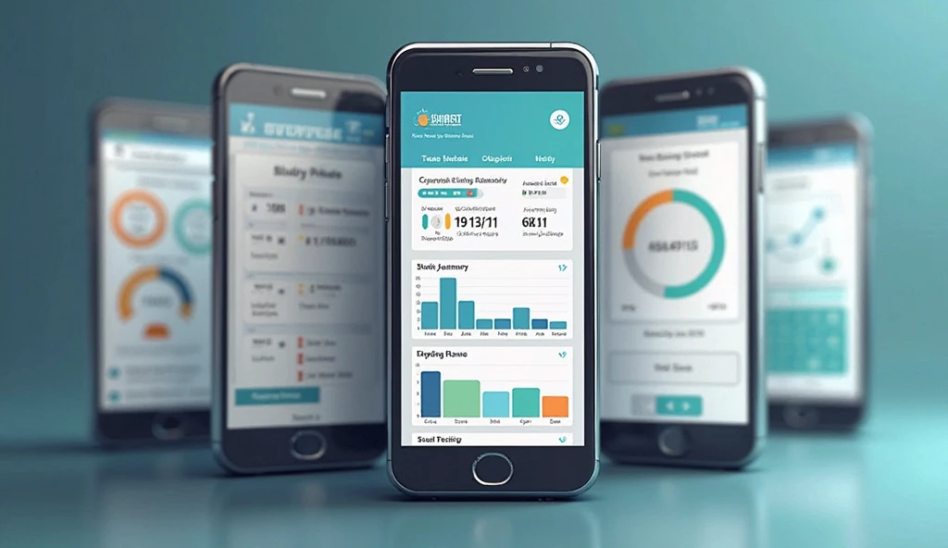
INTRODUCTION:
TrackMyStudy is an Android app designed to help students manage their study routines with three core features: Study Pulse, CT Analyzer and Exam Alert. It offers a stopwatch for tracking daily study time, a tool for recording and averaging test scores, and a countdown reminder for upcoming exams.

Slide 3

PLANNING

Slide 4
PLANNING
1.As my first major project, I aimed to build a straightforward, easy‑to‑use app that would deliver real value to students.
2. Since students use mobile devices for learning, I chose a mobile solution.
3. The core idea was to centralize study data—timing sessions, storing test scores, and scheduling exams—in one place.
4. By simplifying these tasks, the app encourages consistent study habits and reduces the risk of missed deadlines.
5. I prioritized a clean structure and intuitive flow so users of all skill levels could adopt the tool quickly.
6. Ultimately, the goal was to develop an app that not only tracks progress but also actively supports academic success.

Slide 5
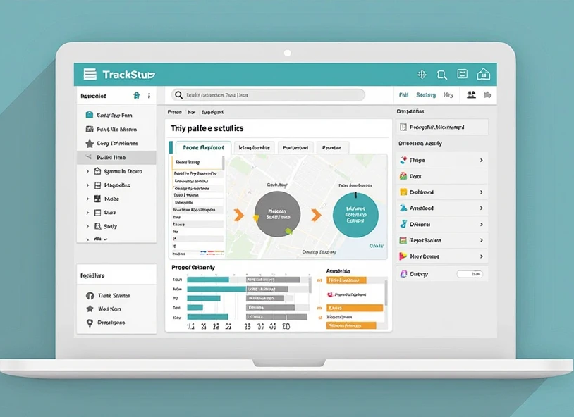
TOOLS

Slide 6
TOOLS
IDE & Build
Android Studio
Gradle
Language:
XML
Java
Frontend Components
XML Layouts
RecyclerView
AlertDialog
DatePickerDialog & TimePickerDialog
Backend Components
Room
TypeConverters

Slide 7
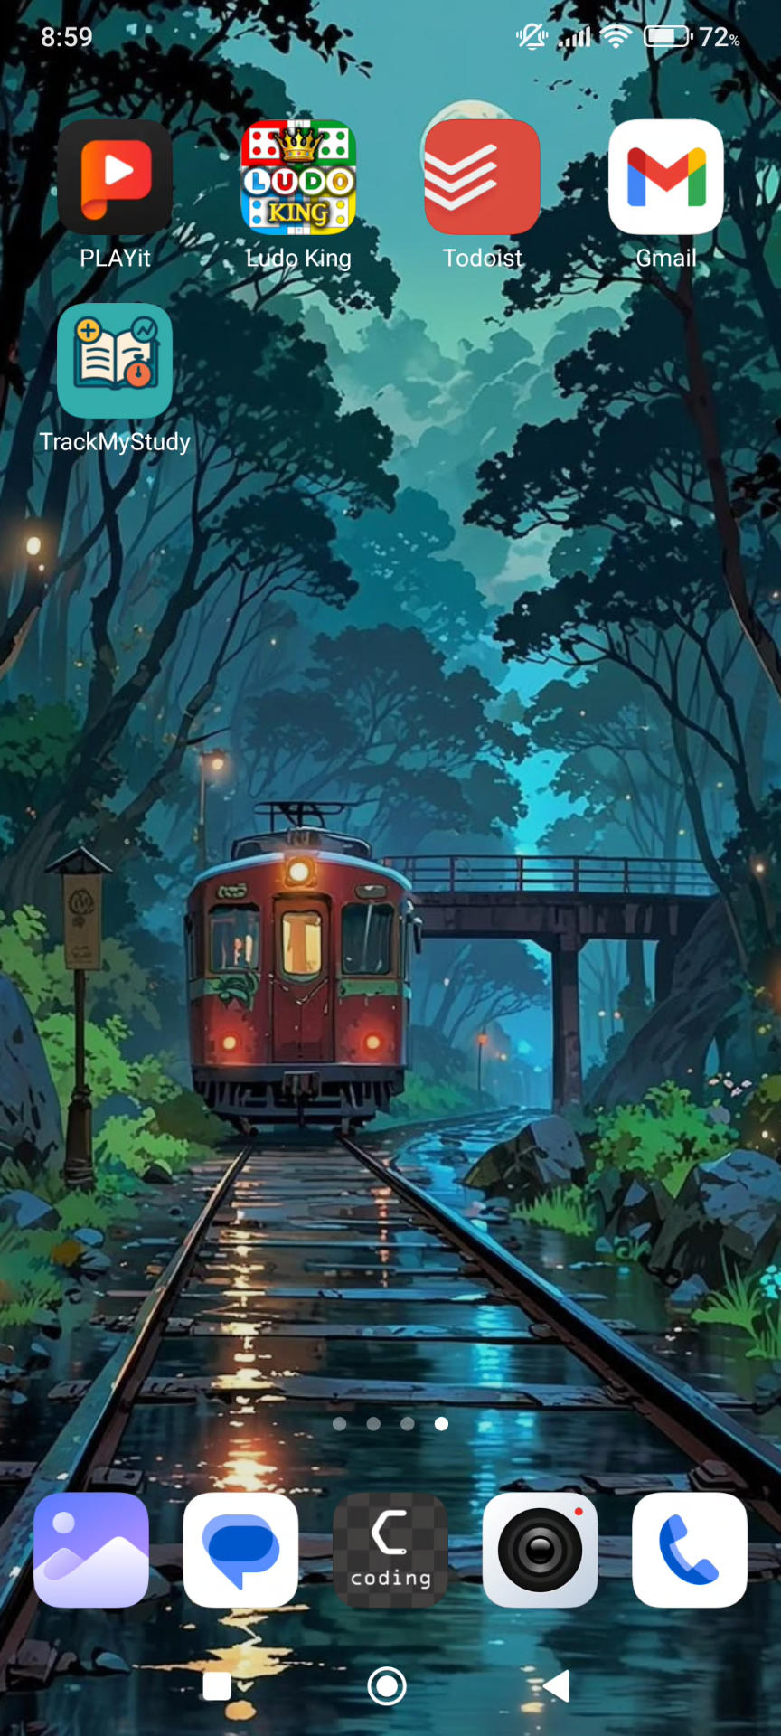
VIDEO

Slide 8
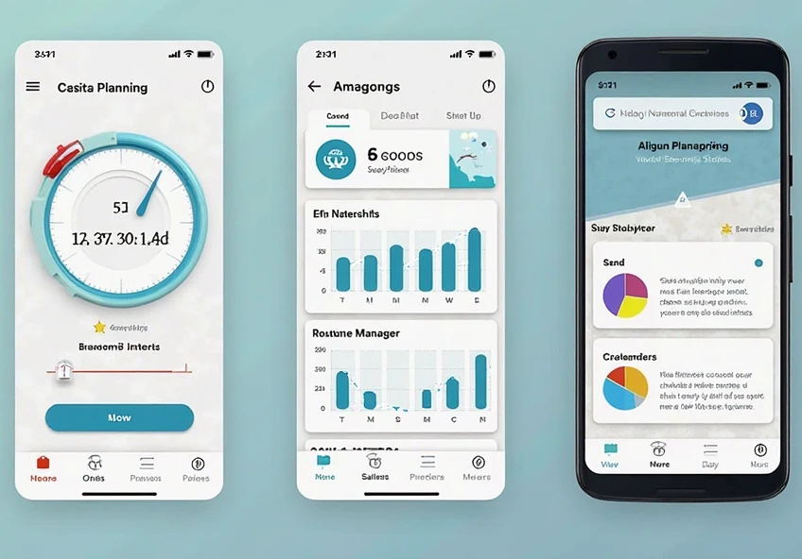
FUTURE PLANNING

Slide 9
FUTURE PLANNING
Add voice commands in Study Pulse to start and stop the stopwatch hands‑free.
Display a 7‑day study summary chart showing daily study durations.
Enhance CT Analyzer with static data graphs for visualizing test score trends.
Introduce a new Routine Manager menu to schedule and remind daily tasks.
Further refine the UI for an even more intuitive, user‑friendly experience.

Slide 10
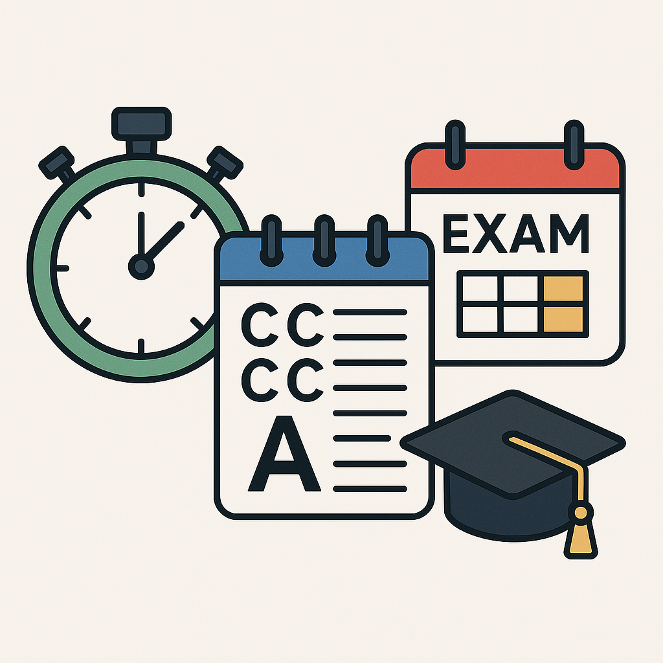
Thank you
Md. Rubayat Ahasn
2203096

